Slide 1
Abstract Data Type
January 11, 2011
Pree Thiengburanathum

Slide 2
Overview
Quiz next class T_T
Tree
Binary Tree
Binary Search Tree
@_@

Slide 3
Selection Sort
12
12
6
12
6
6
22
14
8
17
6
8
12
12
22
14
8
17
8
12
Given n numbers to sort:
Repeat the following n-1 times:
Mark the first unsorted number
Find the smallest unsorted number
Swap the marked and smallest numbers

Slide 4
Selection Sort
12
6
8
22
22
14
22
17
12
12
6
8
12
14
14
17
22
17
17
22
22
Given n numbers to sort:
Repeat the following n-1 times:
Mark the first unsorted number
Find the smallest unsorted number
Swap the marked and smallest numbers

Slide 5
Selection Sort
Given n numbers to sort:
Repeat the following n-1 times:
Mark the first unsorted number
Find the smallest unsorted number
Swap the marked and smallest numbers
How efficient is selection sort?
In general, given n numbers to sort, it performs n² comparisons
Why might selection sort be a good choice?
Simple to write code
Intuitive

Slide 6
Selection Sort
Given n numbers to sort:
Repeat the following n-1 times:
Mark the first unsorted number
Find the smallest unsorted number
Swap the marked and smallest numbers
Try one!
15 | 3 | 11 | 19 | 4 | 7

Slide 7
Selection Sort
for i ← 0 to n do min_j ← i; min_x ← A[i] for j ← i + 1 to n do If A[j] < min_x then min_j ← j min_x ← A[j] A[min_j] ← A [i] A[i] ← min_x

Slide 8
Bubble Sort
12
12
6
6
6
12
12
6
22
14
14
22
8
8
17
22
17
22
14
8
14
8
17
22
17
22
6
14
6
12
12
8
14
14
8
8
17
22
8
14
17
22
Given n numbers to sort:
Repeat the following n-1 times:
For each pair of adjacent numbers:
If the number on the left is greater than the number on the right, swap them.

Slide 9
Bubble Sort
8
6
8
12
6
12
12
8
12
14
17
22
8
14
17
22
8
6
8
12
6
12
14
17
22
14
17
22
Given n numbers to sort:
Repeat the following n-1 times:
For each pair of adjacent numbers:
If the number on the left is greater than the number on the right, swap them.

Slide 10
Bubble Sort
Given n numbers to sort:
Repeat the following n-1 times:
For each pair of adjacent numbers:
If the number on the left is greater than the number on the right, swap them
How efficient is bubble sort?
In general, given n numbers to sort, it performs n² comparisons
The same as selection sort

Slide 11
Bubble Sort
repeat
swapped = false
for i = 1 to length(A) - 1 inclusive do:
if A[i-1] > A[i] then
swap( A[i-1], A[i] )
swapped = true
end if
end for
until not swapped

Slide 12
Bubble Sort
Given n numbers to sort:
Repeat the following n-1 times:
For each pair of adjacent numbers:
If the number on the left is greater than the number on the right, swap them
Try one!
1 | 23 | 2 | 56 | 9 | 8 | 10 | 100

Slide 13
Bubble Sort
1 23 2 56 9 8 10 100
1 2 23 56 9 8 10 100
1 2 23 9 56 8 10 100
1 2 23 9 8 56 10 100
1 2 23 9 8 10 56 100
---- finish the first traversal ----
1 2 23 9 8 10 56 100
1 2 9 23 8 10 56 100
1 2 9 8 23 10 56 100
1 2 9 8 10 23 56 100
---- finish the second traversal ----
…

Slide 14
Insertion Sort
while some elements unsorted:
Using linear search, find the location in the sorted portion where the 1st element of the unsorted portion should be inserted
Move all the elements after the insertion location up one position to make space for the new element
45
38
60
45
66
60
45
66
79
47
13
74
36
21
94
22
57
16
29
81
the fourth iteration of this loop is shown here

Slide 15
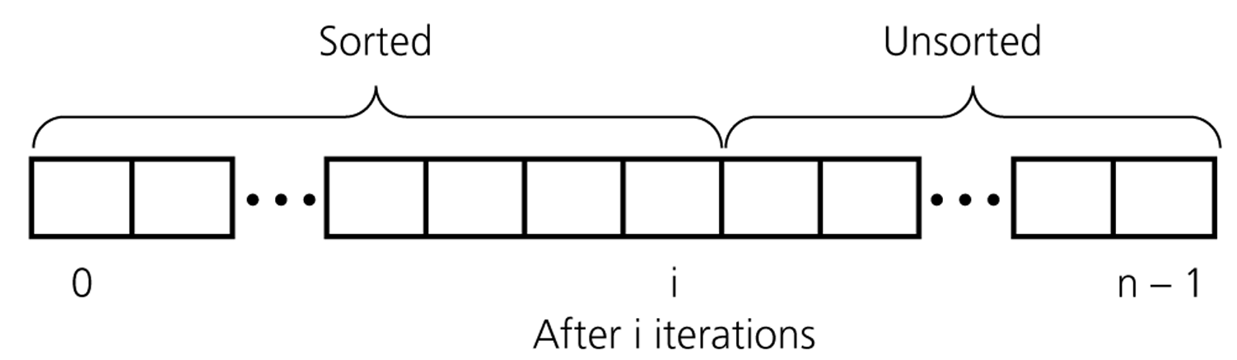
An insertion sort partitions the array into two regions

Slide 16
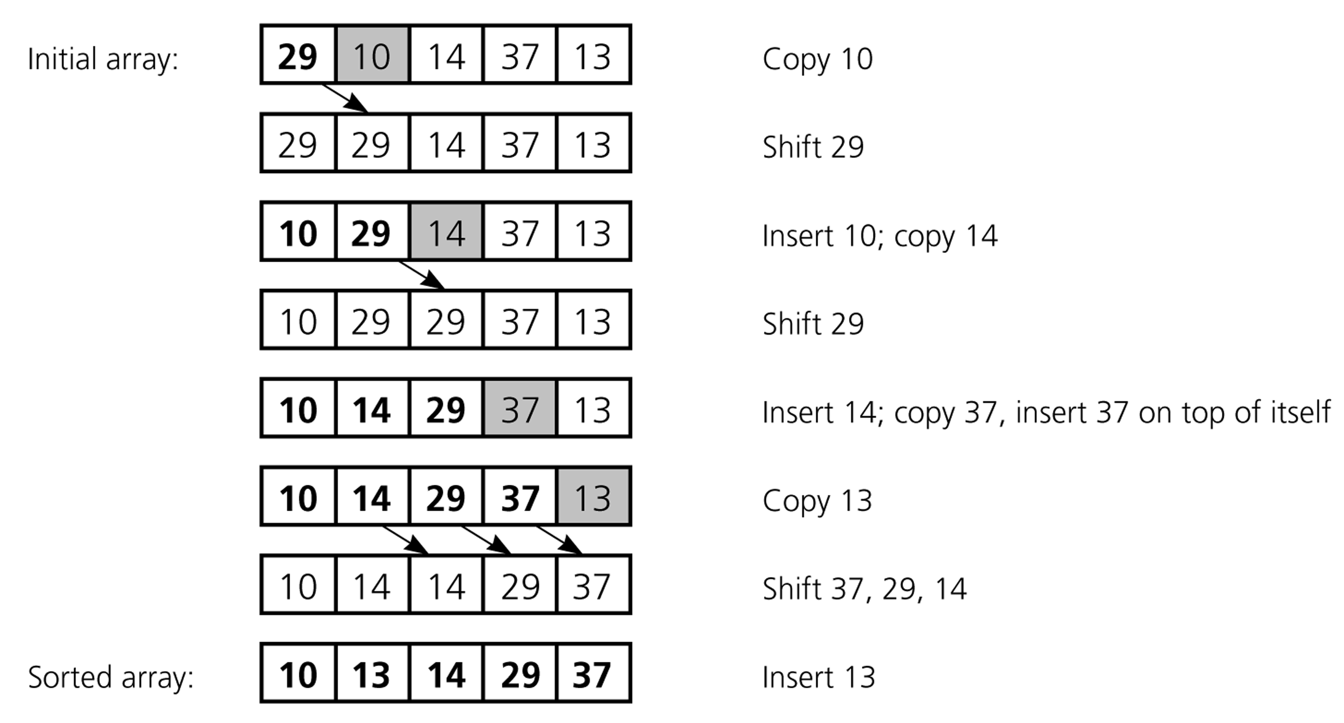
An insertion sort of an array of five integers

Slide 17
Insertion Sort
for i ←1 to i <= length(A)-1
key ← A[ i ]
// A[ i ] is added in the sorted sequence A[0, .. i-1]
j ← i - 1
while j >= 0 and A [ j ] > key
A[ j +1 ] ← A[ j ]
j ← j -1
A [j +1] ← key

Slide 18
Insertion sort
How efficient is bubble sort?
In general, given n numbers to sort, it performs n² comparisons
The same as selection sort and bubble sort

